Slide 1
1 Planed
Planed 1
Study the PEB and TEB
Finish the assignment1 and 64-bit project3.
4

Slide 2
1 Results
Results 1
Write a blog about TEB and PEB. But there are lots of members of the two structures needed to study.
Left some questions about assignmet1About how to deal with the 10-bit number.
Plan to do the 64-bit project3 tomorrow.
4

Slide 3
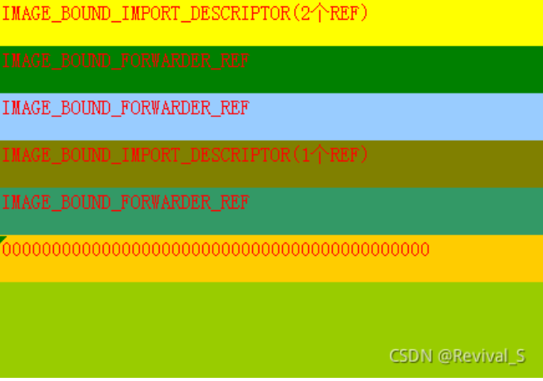
1 Challenges and Solutions
Challenges and solutions 1
At the meeting on Octorber 19th, you said the structure `IMAGE_BOUND_FORWARDER_REF` stores the information of the function in the dll.
Actually the structure `IMAGE_BOUND_IMPORT_DESCRIPTOR` stores the information of API-MS-Win-Core-Profile-L1-1-0.dll and the the structure `IMAGE_BOUND_FORWARDER_REF` stores the information of the ntdll.dll.
4

Slide 4

1 Challenges and Solutions
Challenges and solutions 1
I think it makes the feature of the structure `IMAGE_BOUND_FORWARDER_REF` clear to me. While a dll is bounded, the real address of the function exported by it are written in the IAT.
4

Slide 5
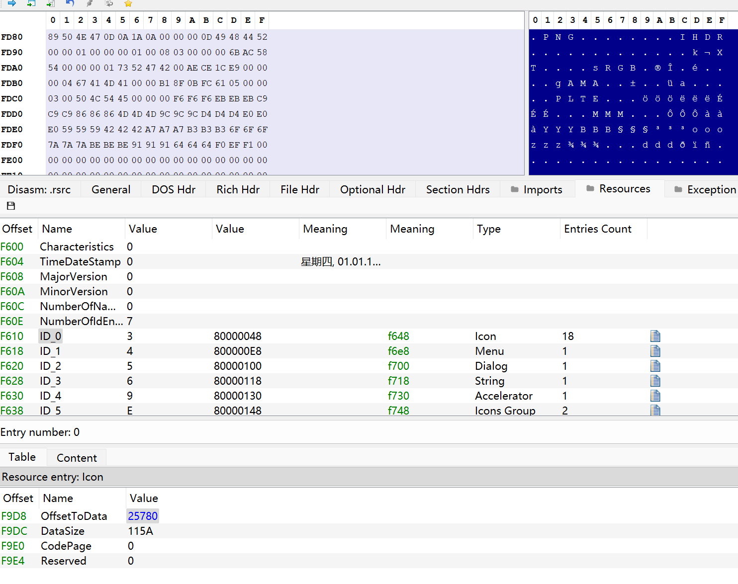
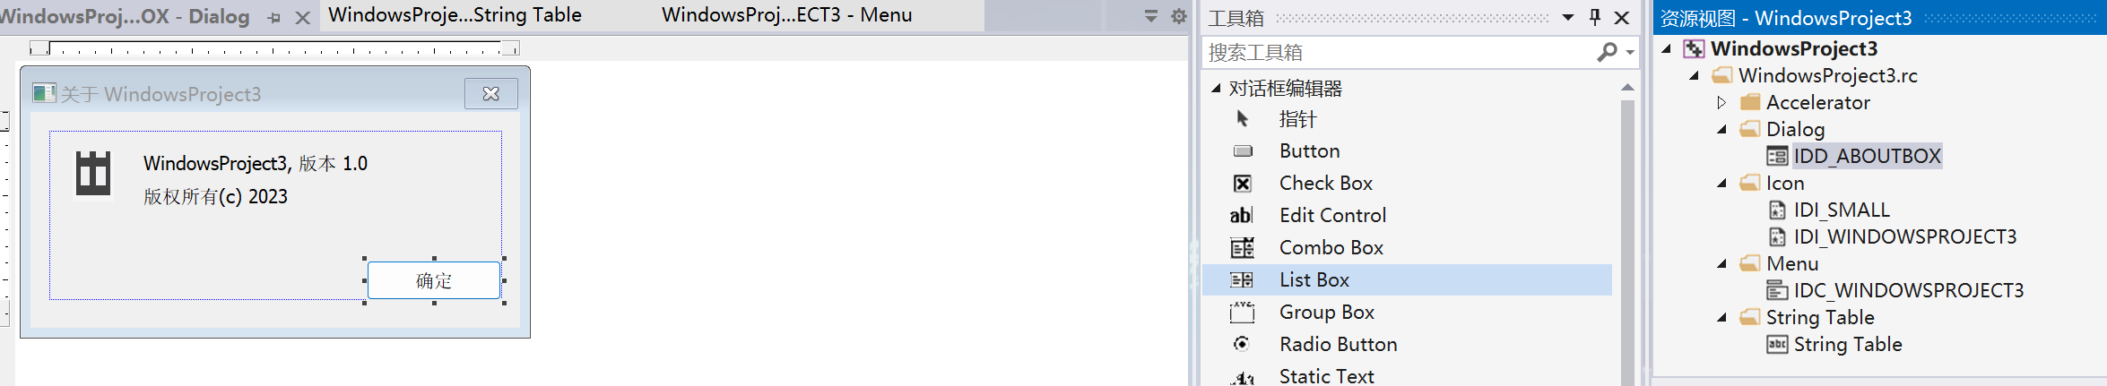

1 Challenges and Solutions
Challenges and solutions 1
Why there are 18 entries points to the structure `PIMAGE_RESOURCE_DATA_ENTRY` ? In my code there is just two files in the directory `ICON`.
I develop a exe, this is how I develop it, and the right screenshot shows the structure of the resource table.
4

Slide 6
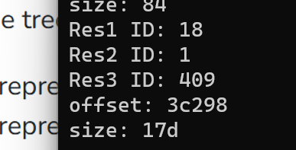
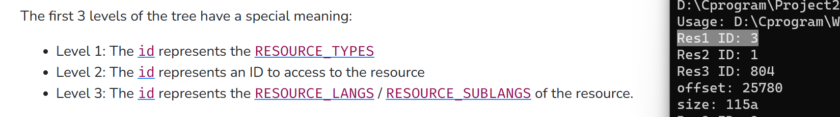


1 Challenges and Solutions
Challenges and solutions 1
I found a serious bug in my program while parsing the resource table. I ignored the third floor.
I look up online and found a article, it said, the ID of the third floor means the language used by the resource.
I am not sure of that. I just know that the most of the ID is 804 and 409 , but do not understand what does it mean.
The link:07 - PE Resources — LIEF Documentation (lief-project.github.io)
4

Slide 7
1 Challenges and Solutions
Challenges and solutions 1
The third parameter is important. Commend line can be obtained by this structure. Next slides I will show you how I get the commend line of a process by vs debugger. And I have some problem about what I get.
4

Slide 8
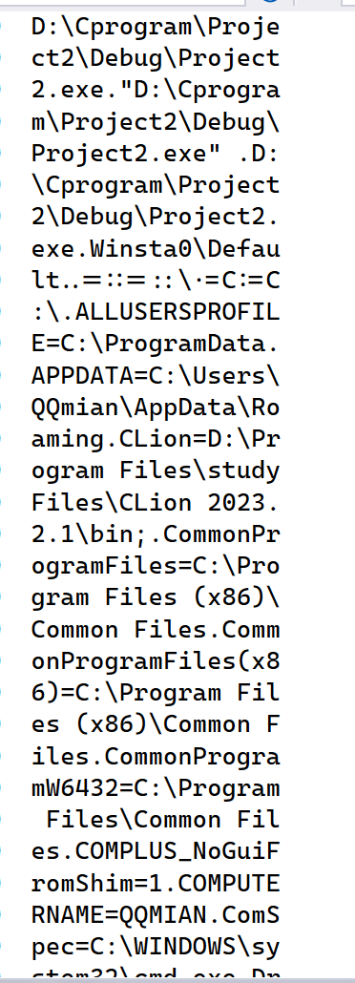
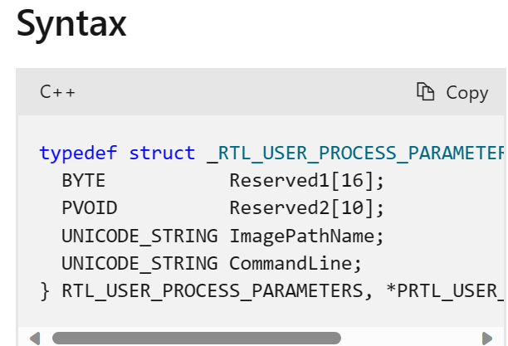
1 Challenges and Solutions
First I disassemble my code and get the start address of PEB. Then `ImageBase + offset` to get the address of the structure `RTL_USER_PROCESS_PARAMETERS*`. `start address + offset` to get the string “CommandLine”.
The screenshot on the right is the result. I thought there is just the path of the exe…..what is it ? Why so many strings?
4

Slide 9
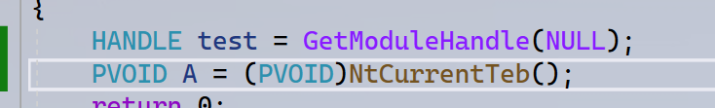
1 Challenges and Solutions
Challenges and solutions 1
I find a api that can get the address of TEB of current thread. It is very useful!
4

Slide 10
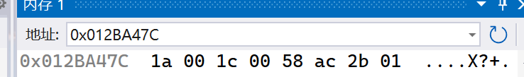
1 Challenges and Solutions
Challenges and solutions 1
I failed to find the dllname which is loaded in the process by PEB.
I solved it, emmmm I ignored the structure `_UNICODE_STRING`. The high 4 bits is the address of the dll name.
LIST_ENTRY InLoadOrderModuleList; //0x0C
LIST_ENTRY InMemoryOrderModuleList; //0x14
LIST_ENTRY InInitializationOrderModuleList; //0x1C
Offet 0xc
PEB
_PEB_LDR_DATA
_LDR_DATA_TABLE_ENTRY
UNICODE_STRING FullDllName; offset:0x24
4

Slide 11
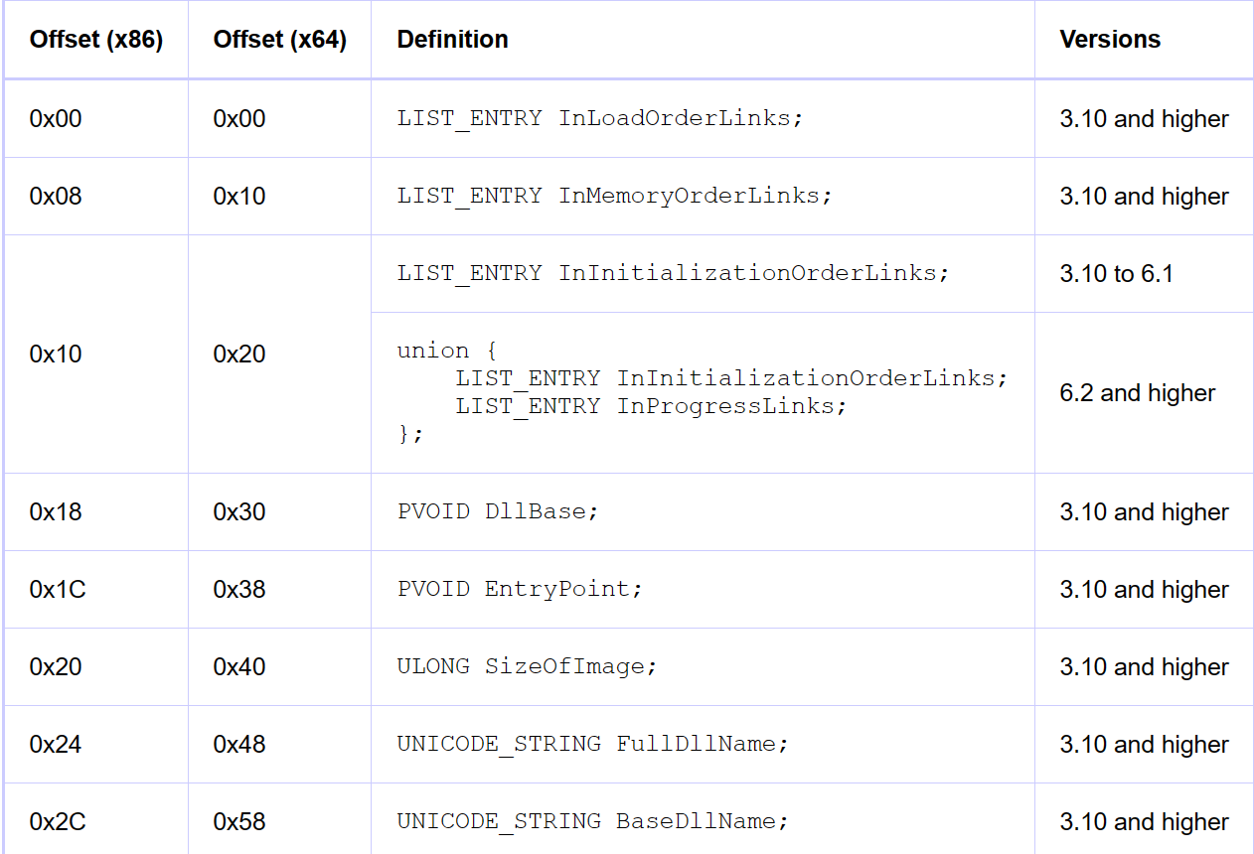
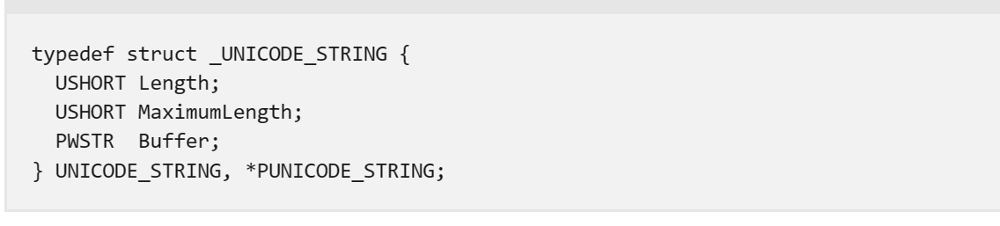



1 Challenges and Solutions
Challenges and solutions 1
I can get the dll name by the first structure `UNICODE_STRING` but , what does the second mean? I can not get anything by the second one.
4

Slide 12
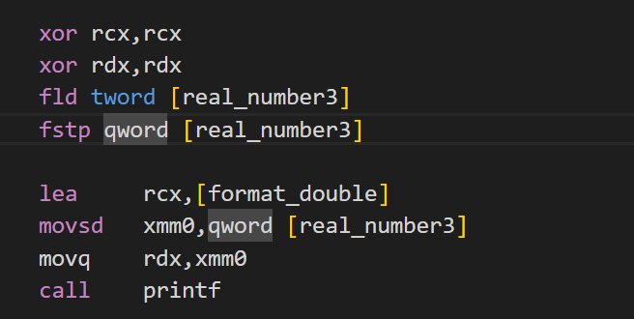
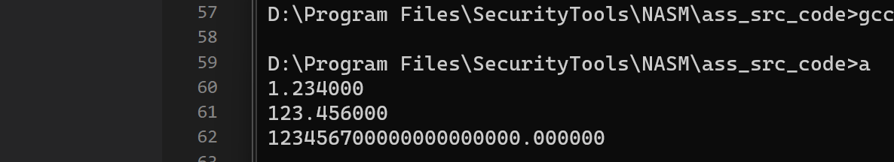
1 Challenges and Solutions
There are some questions about the assignment1.
I did not print the third value as `1.234567e20` but `123456700000000000000.000000` , I wanted to print it as `1.234567e20` , how can I do that?
And I know there is a problem in my code. because the `1.234567e20` can be stored by `double` so I converted the tword into qword. Then print it, it is a trick because I don’t know how to pass the 10-bit size parameter to the function `printf`.
I don’t know how to pass the 10-bit size parameter to the function `scanf`, either.
4

Slide 13
1 Challenges and Solutions
Challenges and solutions 1
Do you know some useful IDE for assembly language? Now I use vs code to write the assembly code and compile and link it by command instructions.
4

Slide 14
1 Plan
plan 1
Solve the problem in the assignment1
Finish the x64 project3
Finish the study of week-02 and week-03 of your course.
4

